Slide 1
Computer numerical control of machine tools and processes
Asimava Roy Choudhury
Professor
Mechanical Engineering Department
Indian Institute of Technology, Kharagpur

Slide 2
Computer Numerical control – what is it ?
Control achieved by the use of
Numbers, symbols, signals, Letters, Codes, Words, instructions
In short, a Language-based communication with machines to be controlled
Inputs to the machine → through numbers, letters and codes
The processing of data → through numerical calculations and logic operations
The execution of operations → through generated signals

Slide 3
Numerical control, computer numerical control
In the beginning – only numbers and alphabets were used to achieve control, together with hard-wired circuitry – there was no computer - so it was just numerical control
Later, with the advent of computers, a computer was used in the process of control – so it became computer numerical control or simply computer control

Slide 4
Area of application of computer control
Is CNC primarily meant for mass (high volume) production ?
Fixed automation → SPM (Special purpose machines) with automated material handling devices are employed in such cases. This helps in reducing machining time, cyclic idle time and non-cyclic time losses.
Why not CNC ? – In mass production, there is hardly any change in part design over extended periods of time. Hence, CNC, which possesses flexibility –is not necessary in mass production.
Why not Fixed automation for low volume production ? In low volume production, part design changes frequently. Fixed automation is not amenable to frequent changes.
But if control is achieved by application of letters, numbers, codes and language, it is easy to change – and that is CNC
Hence – flexibility is the one advantage which makes computer control more suitable than fixed automation in case of low volume production.
In addition, CNC has the ability to manufacture complex shapes without the use of part-specific tooling.

Slide 5

How is computer control achieved ?
Motor
Speed gear box
1:1
Carriage
Feed Gear Box
Nut
By interfacing the machine with a computer
By modifying conventional machine tool architecture
By adding devices which permit the control of motion and other actions from computer
By writing and executing a program from the computer

Slide 6
What is a CNC program ?
A CNC program is a sequence of commands, written in a suitable language, meant for controlling the operations of a machine
When executed, it makes a machine tool carry out some motions and auxiliary operations
As a result, a part is successfully produced from a blank
There are other operations also, apart from machining, which are successfully controlled by CNC program execution.

Slide 7
Example of typical command blocks
N006 G90 G00 X20 Y30
N007 Y50
N008 G01 X100 Y100 F200
N009 G02 X140 R30
N010 M30
Y
(20,50)
(100,100)
(140,100)
r30
(20,30)
X

Slide 8
In mechanical automation
Motion is controlled by physical devices, like Cams, jigs, templates, tracers, limit switches, guides, operators etc
Question – In order to get constant forward feedrate of the cutting tool, what should be the profile of the CAM, which is undergoing uniform circular motion ?

Slide 9
Computer controlled machines
CNC is capable of controlling a machine through
Programmed instructions → Digital signals → rotation of motors → leading to
Achieving a programed extent of motion
Achieving a programmed ratio of axes velocities
Programmed a programmed feed velocity along cutter path

Slide 10
Digital signals, Binary logic and logic gates
Digital circuitry is employed in almost all aspects of CNC control. Example : Data input, data storage, data processing, interpolation, motion execution, feedback etc.
AND
a
c
b
a
OR
c
b

Slide 11
Architecture of the control unit
MCU = DPU + CLU
MCU = Machine control unit
DPU = Data processing unit – contains data entry, data processing, interpolator
CLU = Control loops unit – contains all devices for achieving required motion along an axis (example : The motor, the lead screw-nut, the gear box, the feedback device etc)

Slide 12
What are the modifications of the conventional machine tool
More robust and rigid for the same power level
Backlash elimination, incorporation of recirculating ball screw-nut mechanism
Gear box elimination – gear boxes limit the ratio of axes speeds
Feedback where necessary
Simple kinematic chains / structures instead of complex or compound chains / structures
Motors with lower time constant (faster response)
Interpolator where necessary
Control over displacement, velocity, acceleration of the axes in order to avoid overshoots, sluggish response and resulting inaccuracies in part geometry

Slide 13
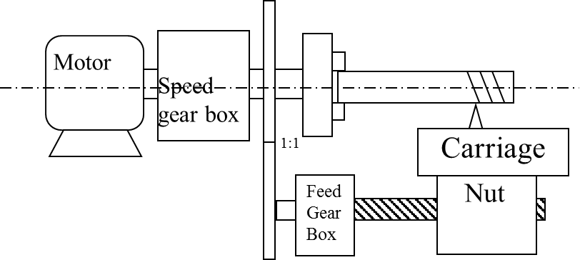
Is it possible to implement computer control on this machine tool ?

Slide 14
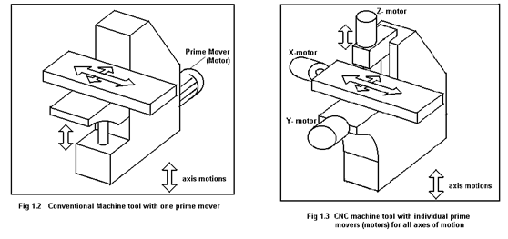
Simple kinematic chains for CNC machine tools

Slide 15
Advantages
Flexibility
It is possible to incorporate automation in low level production
Ability to cut complex profiles
Higher productivity and Accuracy in many applications
Initial investment is high
Required skill level of machinist, operator etc is high
Disadvantages

Slide 16
Practice MCQ questions
Main advantage of CNC machining over Fixed automation is
Flexibility b. Accuracy
c. Speed d. None of the others

Slide 17
Binary logic and logic gates
2nd Lecture for the open online course "Computer numerical control (CNC) of machine tools and processes "

Slide 18
Signals / variables which can take up only 2 values – Binary variables
Power supply
A = 0 volts
t, seconds
A = 5 volts
Power supply
t, seconds
A = Pulsed 5/0 volts
Power supply
t, seconds

Slide 19
Truth tables for some logic operations
A | B | A/ | B/ | A + B | A.B | A⊕ B | A#B
1 | 1 | 0 | 0 | 1 | 1 | 0 | 0
1 | 0 | 0 | 1 | 1 | 0 | 1 | 1
0 | 1 | 1 | 0 | 1 | 0 | 1 | 1
0 | 0 | 1 | 1 | 0 | 0 | 0 | 1

Slide 20
Binary logic operations
law of complements
a + a/ = 1
a . a/ = 0
a + 1 = 1
a . 0 = 0
a . 1 = a
a + 0 = a
• Commutative law
a + b = b + a
a.b = b.a
• Distributive law
a.(b + c) = a.b + a.c
• associative law
a + b.c = (a + b) . (a + c)
• De Morgan’s laws
(a + b)/ = a/ . b/
(a . b)/ = a/ + b/

Slide 21
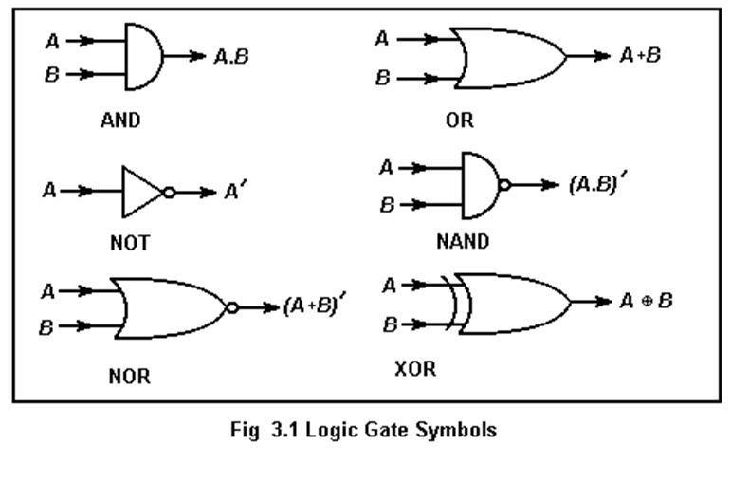
Symbols for logic gates

Slide 22
Addition of two bits
Decimal Binary
1 + 1 = 2 1 + 1 = 10
1 + 0 = 1 1 + 0 = 1
0 + 1 = 1 0 + 1 = 1
0 + 0 = 0 0 + 0 = 0
A | B | Carry | Sum
1 | 1 | 1 | 0
1 | 0 | 0 | 1
0 | 1 | 0 | 1
0 | 0 | 0 | 0
A | B | A/ | B/ | A + B | A.B | A⊕ B
1 | 1 | 0 | 0 | 1 | 1 | 0
1 | 0 | 0 | 1 | 1 | 0 | 1
0 | 1 | 1 | 0 | 1 | 0 | 1
0 | 0 | 1 | 1 | 0 | 0 | 0

Slide 23
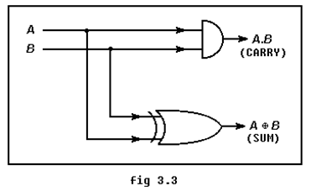
A half adder – can add up two bits

Slide 24
Addition of 2 bytes
Carry 1011111
11011011
+ 11001111
110101010
You might well have to add 3 bits together

Slide 25
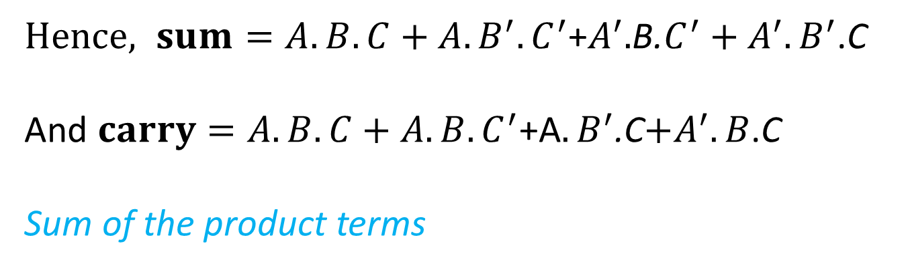
Addition of 3 bits
a | b | c | carry | sum
1 | 1 | 1 | 1 | 1
1 | 1 | 0 | 1 | 0
1 | 0 | 1 | 1 | 0
1 | 0 | 0 | 0 | 1
0 | 1 | 1 | 1 | 0
0 | 1 | 0 | 0 | 1
0 | 0 | 1 | 0 | 1
0 | 0 | 0 | 0 | 0
The sum takes up a value of 1 if
A and B and C are all 1
Or A is 1 and B is 0 and C is 0
Or A is 0 and B is 1 and C is 0
Or A is 0 and B is 0 and C is 1
$Hence, sum=A.B.C+A.B^{′}.C^{′}$+$A^{′}.$B.$C^{′}+A^{′}.B^{′}$.C
And$carry=A.B.C+A.B.C^{′}$+A$.B^{′}$.C$+A^{′}.B$.C
Sum of the product terms

Slide 26
The value of carry
Carry = A.B.C + A.B.C/ + A/.B.C + A.B/.C
= A.B.C + A.B.C/ + A.B.C + A/.B.C + A.B.C + A.B/.C
= A.B.(C+C/) + B.C.(A+A/) + A.C.(B+B/)
= A.B + B.C + A.C

Slide 27
The value of Sum
Sum = A.B.C + A.B/.C/ + A/.B.C/ + A/.B/.C = A . (B.C + B/.C/) + A/. (B.C/ + B/.C)
Now, B.C/ + B/.C = B ⊕ C , and
(B.C + B/.C/)/ = (B.C) / . (B/.C/)/ = ( B/ + C/ ) . ( B + C ) = B.B/ + B.C/ + B/.C + C.C/
= B.C/ + B/.C = (B ⊕ C) /
Hence,
A . (B.C + B/.C/) + A/. (B.C/ + B/.C) = A.(B ⊕ C)/ + A/ . (B ⊕ C) = A ⊕ B ⊕ C

Slide 28
Numerical problem 2.1
There is a grinding machine in which coolant is to be applied automatically if
The temperature ≥ 60° C , surface speed ≥ 20 m/s & table feed ≤ 15 m/min
The temperature ≥ 60° C , surface speed < 20 m/s & table feed > 15 m/min
The temperature ≥ 60° C , surface speed ≥ 20 m/s & table feed > 15 m/min
If sensors are set up in such a way that the following variables
A = 0 when temperature < 60° C
= 1 when temperature ≥ 60° C
B = 0 when surface speed < 20 m/s
= 1 when surface speed ≥ 20 m/s
C = 0 when feed ≤ 15 m/min
= 1 when feed > 15 m/min
Make a circuit which would send an output signal S = 1 when coolant is supposed to be applied, otherwise 0.
Grinding machine
Coolant
A
?
B
S=1/0
C

Slide 29
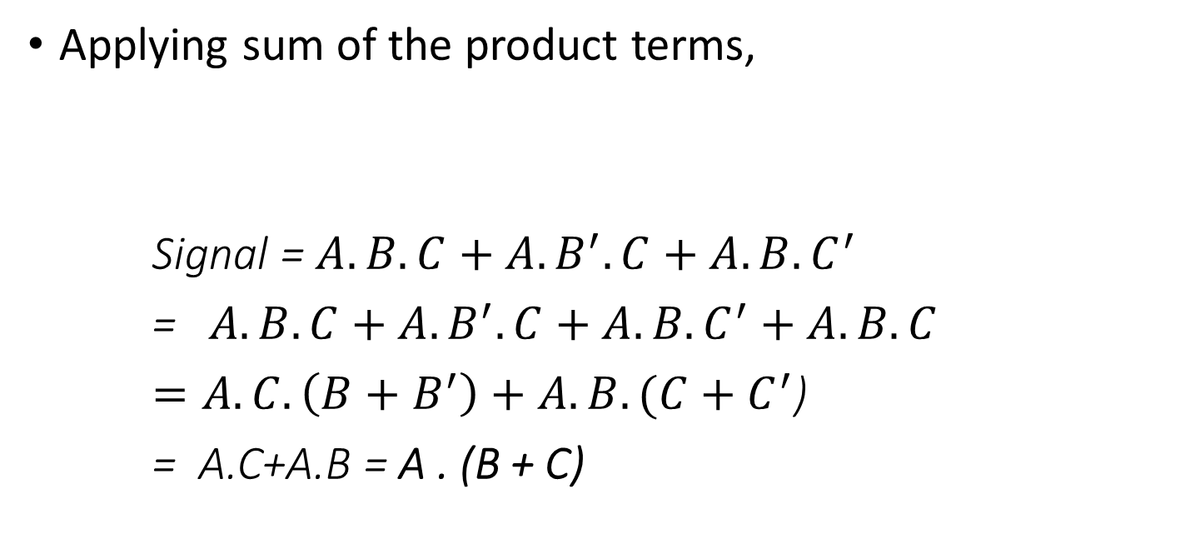
Solution to Prob 2.1
A | B | C | signal
1 | 1 | 1 | 1
1 | 1 | 0 | 1
1 | 0 | 1 | 1
1 | 0 | 0 | 0
0 | 1 | 1 | 1
0 | 1 | 0 | 0
0 | 0 | 1 | 0
0 | 0 | 0 | 0
Applying sum of the product terms,
Signal = $A.B.C+A.B^{′}.C+A.B.C^{′}$
=$A.B.C+A.B^{′}.C+A.B.C^{′}+A.B.C$
$=A.C.\left(B+B^{′}\right)+A.B.(C+C^{′}$)
= A.C+A.B = A . (B + C)

